Slide 1
Presented by Ron Hester, CAC Chair
IFTA Clearinghouse Advisory Committee (CAC) Update

Slide 2
IFTA CAC Membership

Slide 3
IFTA CAC Purpose
Provides technical guidance on the components of the IFTA, Inc. Clearinghouse.
Ensures that there is consistency, quality and timeliness of submitted data.
Advises the IFTA, Inc. Board and CEO of IFTA, Inc. on the operation of the Clearinghouse.
Works to enhance membership accessibility and usage.

Slide 4
IFTA CAC Update
Face-to-Face Meeting
Best Practices Guide: Demographic/Transmittal
Quality Control
Jurisdiction Contact

Slide 5
IFTA CAC Future Initiatives
CAC Charter Review/Update
Clearinghouse Access/Usage
Webinar

Slide 6
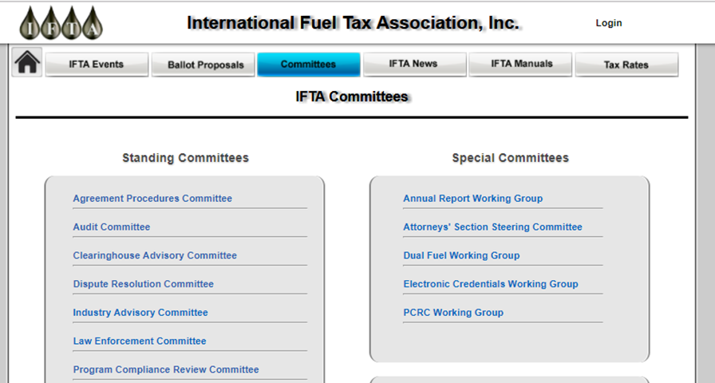
IFTA CAC Information

Slide 7
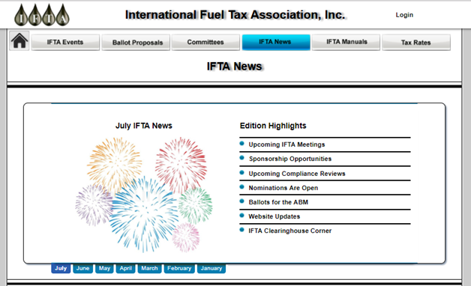
IFTA CAC Information

Slide 8
IFTA Audit Committee Update
Presented by
Helen Varcoe (MT), Chair

Slide 9
AUDIT COMMITTEE
Audit Committee Members:
Helen Varcoe, Chair, MT Beth Duda Vice Chair, AZ
Dave Nicholson, Ex-Officio, OK Kelly Heaton, AR
Bob Gattinella, RI Jimmy Tompkins, AL
Joel Foreman, NE Lynden Landholm, KS
Kristie Zanis, NH Marsha Douglas Roy, QC
Betsy McCabe, NV Bille Pierson, ID
Board Liaisons: IFTA Inc., Advisors:
Steve Nutter, VA Debbie Meise
Joy Prenger, MO Tammy Trinker
Rick LaRose, CT

Slide 10
AUTHORITY AND PURPOSE:
The AC is established by the IFTA Articles of Agreement pursuant to Article R1810.200.020.
The purpose of the AC is to review and maintain the IFTA Audit Manual, and to complete other responsibilities assigned to it by the International Fuel Tax Association, Inc. (IFTA, Inc.) Board of Trustees (Board).

Slide 11
COMMITTEE RESPONSIBILITIES:
A. advising the IFTA membership regarding audit matters,
B. in the discharge of its responsibilities, seeking input from other committees formed
pursuant to the IFTA,
C. planning and conducting an annual audit workshop;
D. reviewing and commenting on ballot proposals,
E. reviewing and preparing responses for consensus board interpretation drafts referred to
it by the Board,
F. developing ballot proposals and Board interpretation requests,
G. maintaining a committee member rotation chart,
H. recruiting members and maintaining a list of potential committee members,
I. making recommendations to the Board to fill committee vacancies,
J. maintaining the IFTA Best Practices Audit Guide, and
K. maintaining a New Member Guide.

Slide 12
BALLOT REMINDER
BALLOT 3 – EFFECTIVE JANUARY 1, 2017 LANGUAGE CHANGES
BALLOT 4 – EFFECTIVE JULY 1, 2017 IFTA AUDIT COUNTS

Slide 13
BEST PRACTICES GUIDE
AC is currently working on the update to this guide
Incorporation of the new ballot language and technological advances.
Appendices Section with examples for guidance.

Slide 14
2018 IFTA/IRP AUDIT WORKSHOP
The IFTA / IRP Audit Workshop provides a variety of educational and networking opportunities created with IFTA and IRP auditors in mind. Each year attendees participate in "hands-on” case studies. The workshop can benefit both new and experienced auditors alike. Attendees include both jurisdiction auditors and industry stakeholders.
ASSC – Workshop will be at the same time, same place. Presentations will be given at each by the other committee.
February 13-15, 2018
Crowne Plaza San Marcos, Chandler AZ

Slide 15
IFTA Attorney’s Section Steering Committee
Update Presented by
Paul Nilsen (WI), Chair

Slide 16
Attorneys’ Section Steering Committee Members
Paul Nilsen, Chair
WI Dept. of Transportation
France Vandenberg, Vice-Chair
ON Ministry of Finance
Ed Beaudette
MT Dept. Of Transportation
James Clark
IN Dept. of Revenue
James Cook
TX Comptroller of Public Accounts
Jack Frehafer
PA Dept. of Revenue
David Poore
BC Ministry of Finance
Kevin Smith
CA Dept. of Tax and Fee Admin.
Clark Snelson
UT State Tax Commission
Board Liaisons
Stuart Zion (CO)
Antoinette Tannous (QC)
Chuck Ulm (MD)
Notes:
Regional representation
Like other committees, various agencies administer motor fuel tax
Vacancy—any attorney from member jurisdiction?

Slide 17
Attorneys’ Section Steering Committee Charter
“The purpose of the Section is to provide training for jurisdiction attorneys and to provide a forum to discuss and resolve potential areas of conflict involving legal issues.”
Established April 1998, as a special committee
Responsibilities:
Training—familiarize attorneys with their IFTA responsibilities, provide CLE instruction for litigation support, forum to review ongoing issues and strategies
Facilitate cooperation between jurisdictions; informal conflict resolution
Review ballot proposals for legal implications

Slide 18
Attorneys’ Section Steering Committee Activities
Monthly conference calls
Caselaw updates
Regulatory and legislative updates
IFTA Ballot Reviews
Annual meeting
Educate attorneys and network
Next meeting: Feb. 13-14, 2018, with Audit Committee
Notes:
Caselaw updates (track active cases), Ex.-Cougar Den—WA case held that a tribal wholesale fuel distribution company is exempt from paying taxes on fuel brought to the Yakama Indian Reservation from Oregon under a treaty between the federal government and the tribe; July 26 appeal to US Sup Ct
regulatory or legislative changes (recent CA changes to Bd Equalization)

